Slide 1
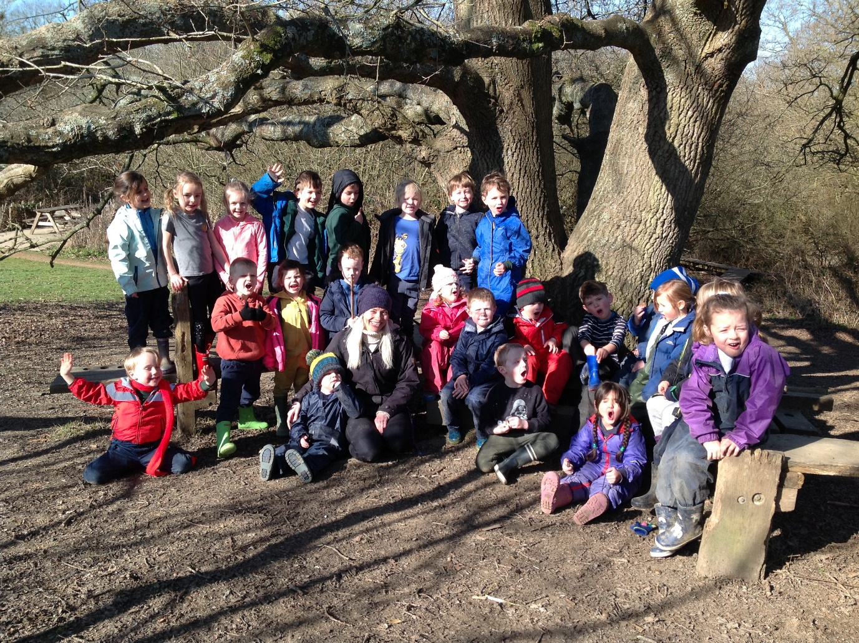
Welcome to Barcombe Primary School

Slide 2
We are a small but ‘mighty’ school. We deliver an active and engaging curriculum that challenges and inspires all, and encourages everyone to embrace 'life in all its fullness'. Our emphasis is about learning to learn whilst promoting a Christian ethos. We believe everyone can achieve!

Slide 3
Current structure of the Early Years Foundation Stage
Hedgehog Class
Mrs Amy Whittle – Class Teacher
Ms Violet Baker – Teaching Assistant

Slide 4
Early Years Foundation Stage Curriculum
Barcombe School follows the ‘Early Years Foundation Stage Guidance’ which supports each child to take their next steps and follow their learning interests.
Our curriculum is play-based, filled with practical and fun experiences to support thinking and learning.

Slide 5
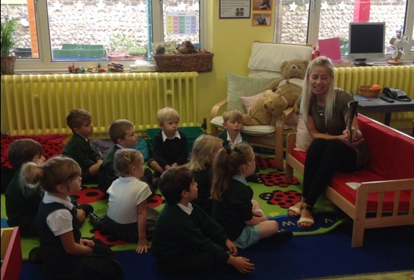
Transition from Pre-school
Phone calls to pre-schools
Handover of information about your child
Transfer of Tapestry (online learning journal)
Virtual tour of Barcombe School and Hedgehog Classroom.
Story videos on the website.
Owl Babies activities from home to school.

Slide 6
Transition Events
Meet the teachers in the garden.
June 22nd or June 23rd 1.30-2.30pm
Stay and Play session
July 6th or July 7th 1.30-2.30pm
Family Visit
Staggered start timetable
Please see your pack for which sessions you can attend.

Slide 7
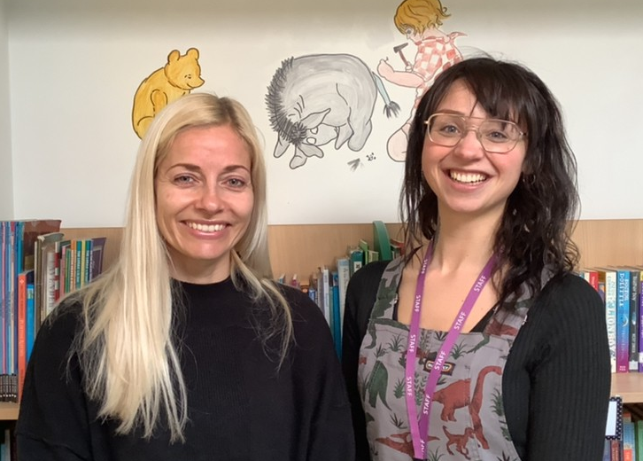
Meet the teachers
Come to meet Mrs Whittle and Ms Baker outside in our garden.
If you have any
questions you want
to ask.
Time to play in our
garden and become
familiar together.

Slide 8
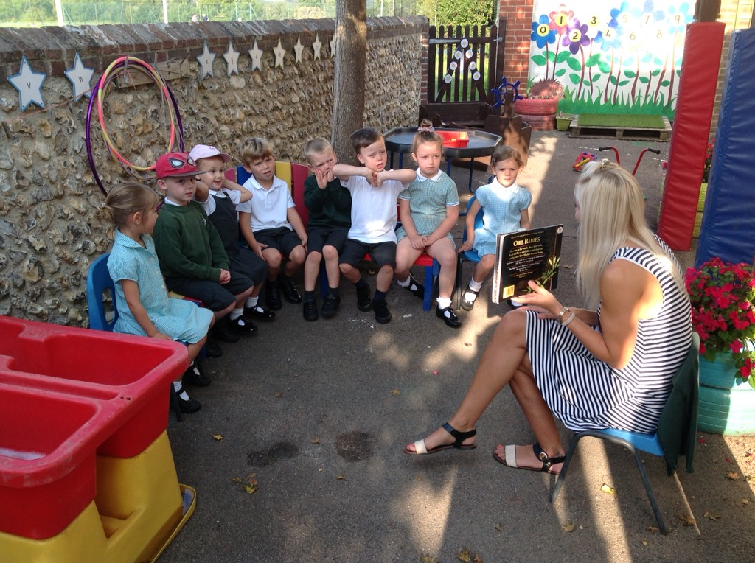
Stay and Play
Stay and play session for you and your child to become familiar with our new environment.
Small groups.
Time to go inside the
Classroom with your child
and have a look around.

Slide 9
Family School Visit
An opportunity for us to meet you and your child in their new classroom and talk with you about their experiences so far.
Family School Visits will take place Thursday 2nd September, Monday 6th September and Tuesday 7th September,
between 9am and 3pm (see welcome pack for your time).

Slide 10
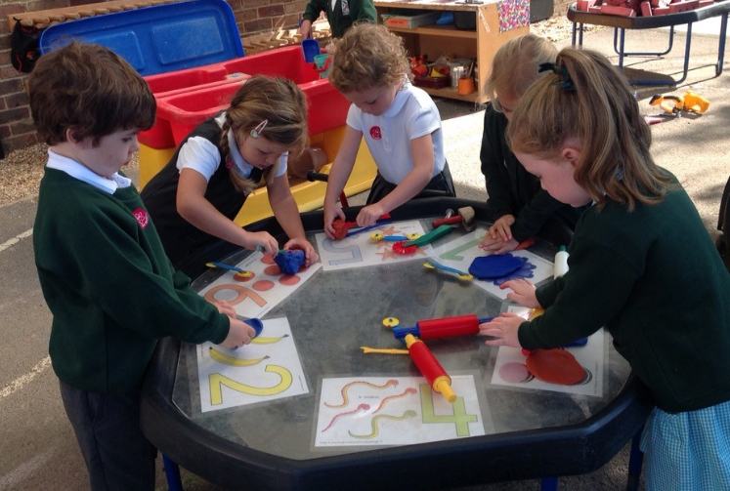
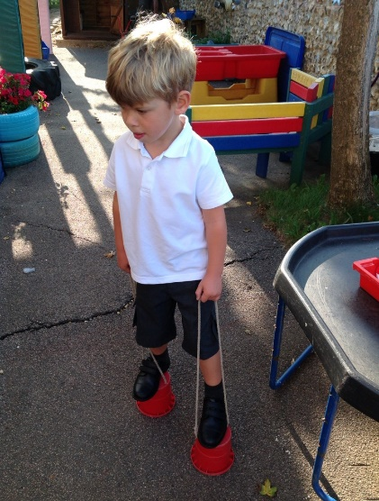
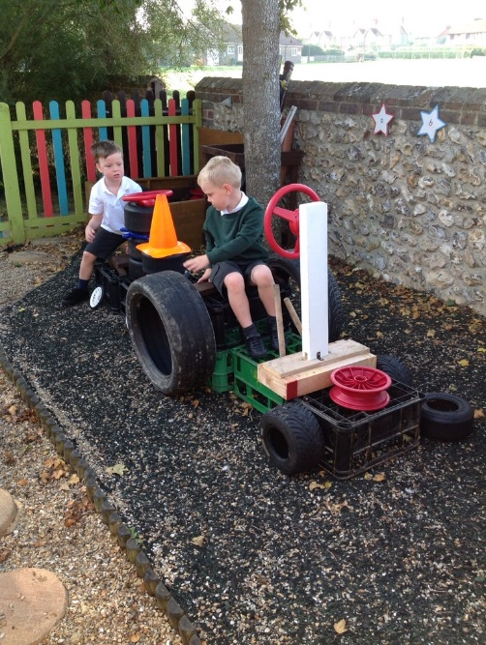
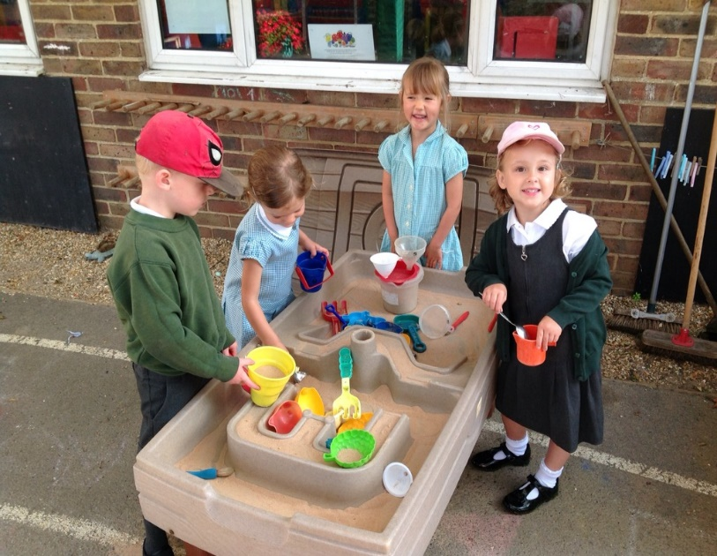
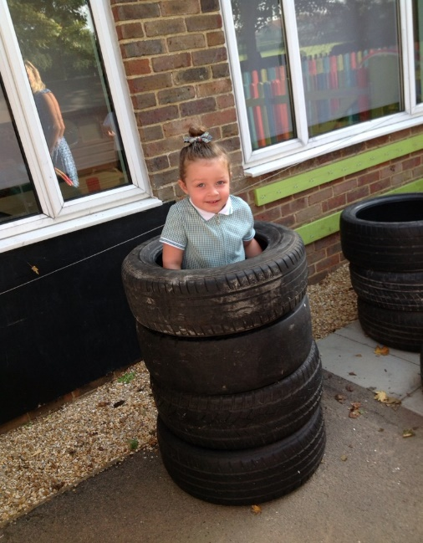
What might you see?

Slide 11
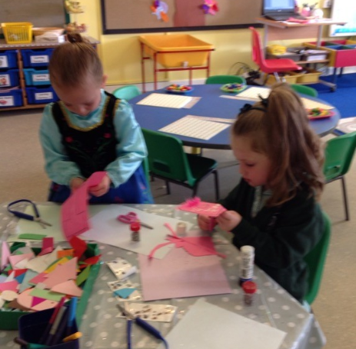
A Good Start
Half day sessions for two weeks – Your child will be in school for either a morning or an afternoon each day.
Small groups so we can all get to know each other.
All children have experience of lunch times before full time.
All children invited to come full time from Monday 20th September, if this suits your child’s needs.
Part time option if you choose.
- If you feel your child would benefit from being part time for a little longer, please speak to Mrs Whittle.
We want starting school to be a positive and happy next step for all children.
Please see your pack for full details of our transition timetable.

Slide 12
A day in Hedgehog Class…
8.45 Bell rings on the playground and we all line up and walk into class together.
8:45-9:00 Greeting children and parents and self-initiated play inside
(please do come in and settle your child)
9.00-9.20 morning routine and phonics or maths
9.20-11.40 Teacher led focus groups / self-initiated learning inside and outside
10:00-10:40 Rolling snack and milk time
11.40 Phonics or maths
12:00-1:00 Lunch time
1:00-1:10 Register and yoga or relax time
1:10- 1.30 Dance/P.E. or ring games/circle time
1.40-3.00 1:1 Reading, teacher led focus groups /self-initiated learning
2.40-3.00 Story and singing time (please wait in the Hedgehog Garden to collect your child)

Slide 13
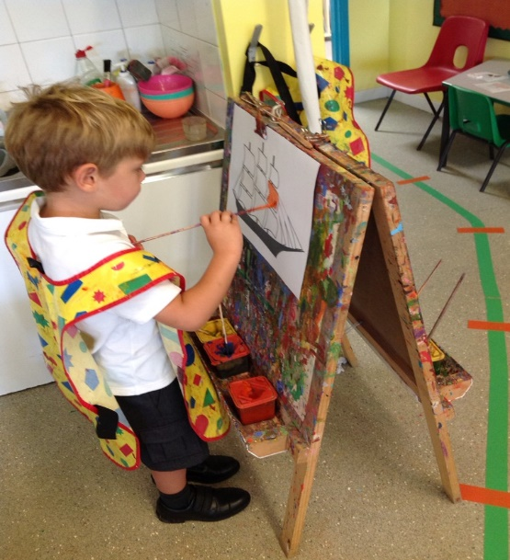
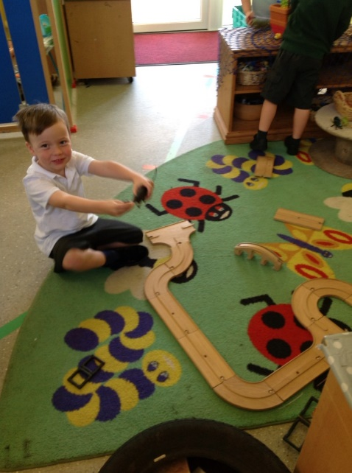
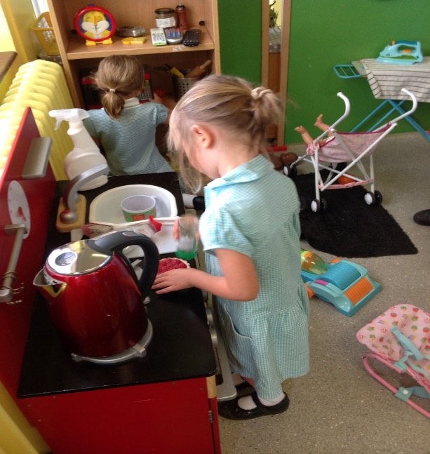
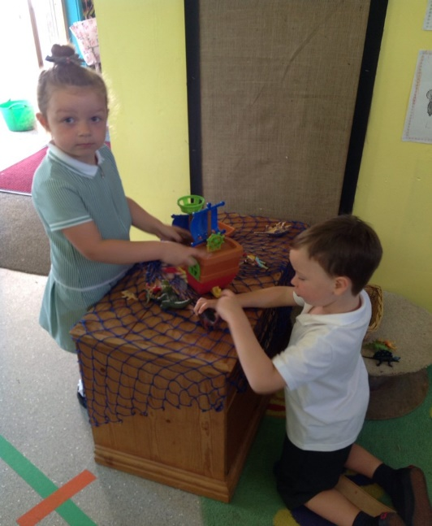
Inside our classroom…

Slide 14
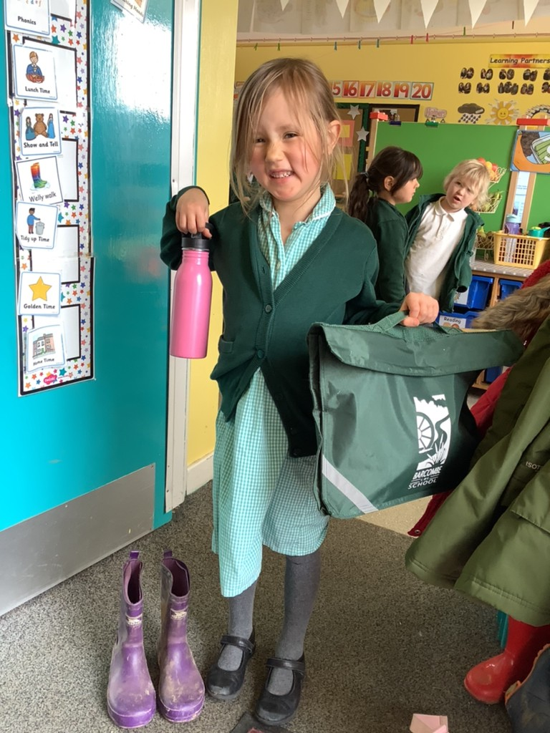
What do I need to bring?
School Uniform
Bag with a change of clothes
Welly Boots
Water bottle
Something special
Healthy snack – Fruit/
oat bar/crackers/rice cake
I will give you your book bag
on your first day at school.

Slide 15
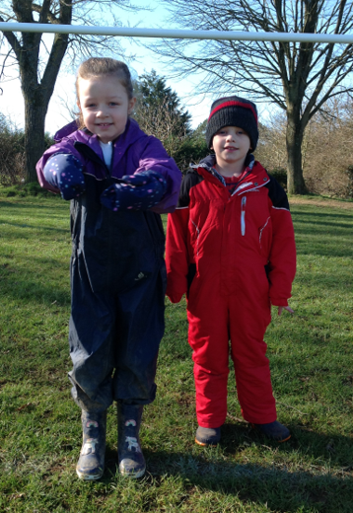
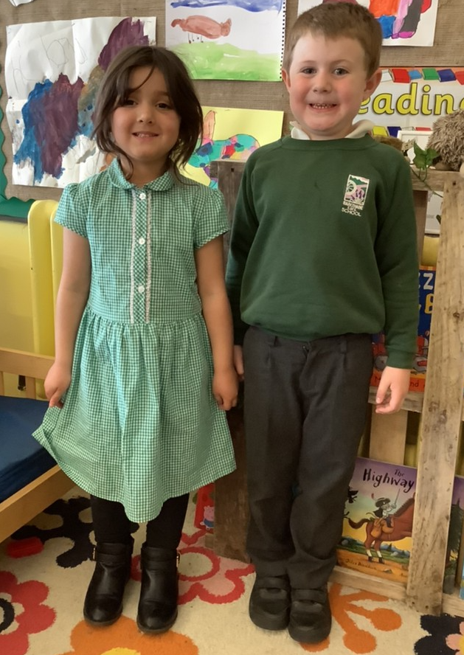
School Uniform
On PE days we come to school in our PE kit for the day.
School Uniform
Welly Walk Days!

Slide 16
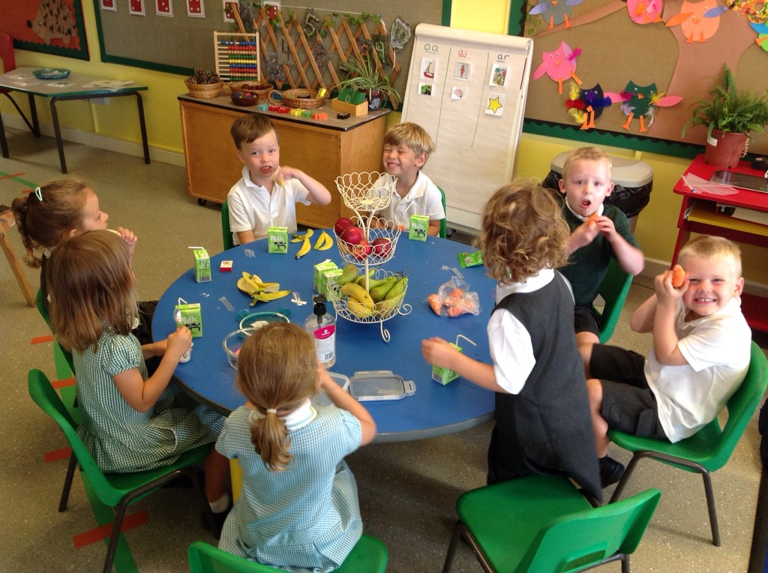
Snack time
Everyday we have a selection of fruit available for snack time.
You may want to send in a healthy snack that you know your child will eat as well. Please pop it in a named pot.
Milk is free and
available to all
children under
5 years old.

Slide 17
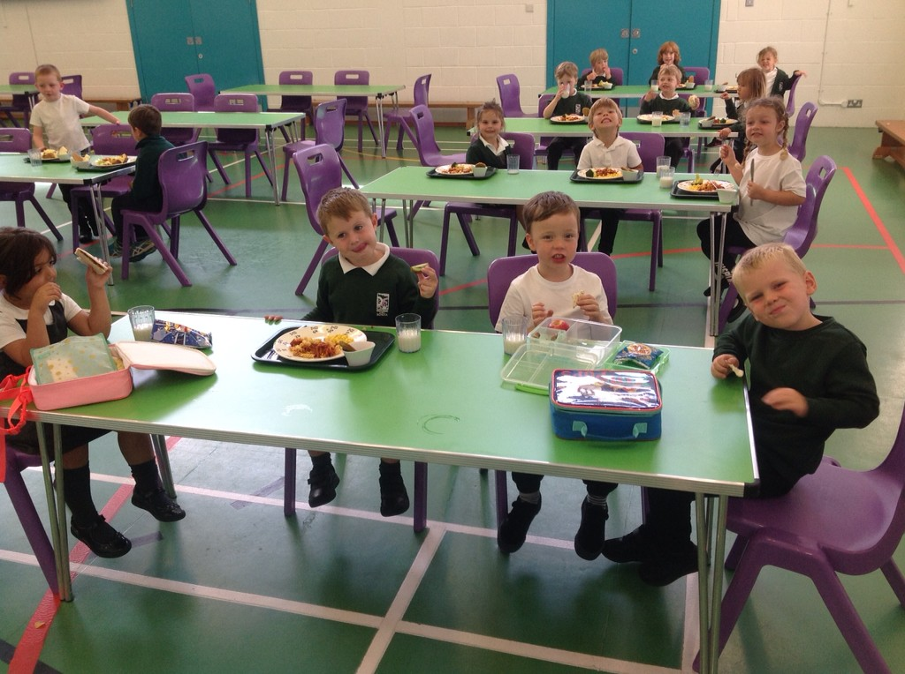
Lunch time
Free school meals for reception children.
Or packed lunch.
Lunch menu is in your pack.
Children can choose each morning what they would like for lunch.
We will all sit together.
Mrs Whittle or
Ms Baker will settle
the children in the
lunch hall/Sports hall.
After lunch, we all go out to
the Playground for a play
with our Friends.

Slide 18
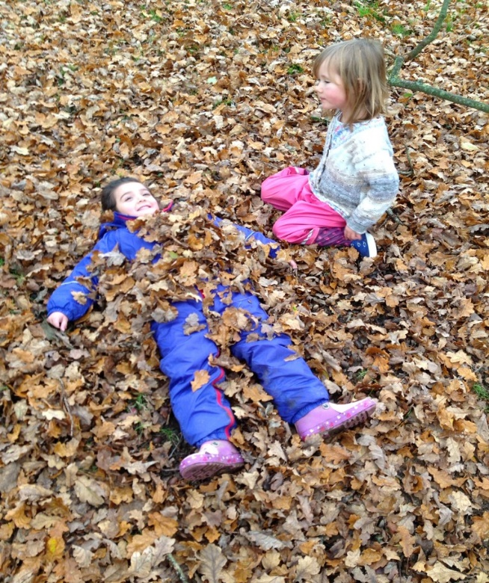
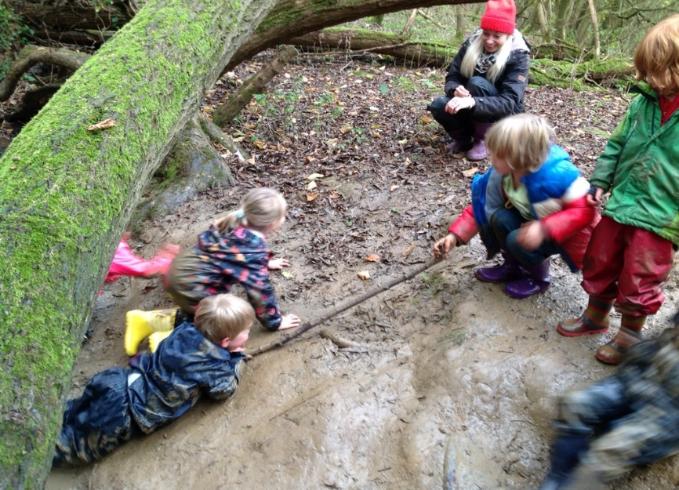
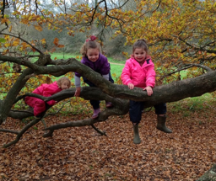
Welly walks
Every Wednesday we go on a Welly Walk to Wild About Barcombe.
We come to school in our old clothes and a waterproof suit, so we can have lots of fun and keep dry and warm.
This is super time to grow our
friendships and self-confidence.

Slide 19
If you have questions do contact the school office and we will respond.
Mrs Whittle can give you a call if necessary.

